Slide 1


Mohammed Abu Hasan
31/10/2021

Slide 2
Outline
Executive Summary
Introduction
Methodology
Results
Conclusion
Appendix

Slide 3
Executive Summary
What is the price of each SpaceX launch?
Will SpaceX re-use the first stage of a launch with given variables/parameters?
I.e. Will the first stage of the launch land successfully?
We have gathered data of previous SpaceX launches and their landing outcomes
Cleaning the data enabled us to analyze our findings
We visualized the data to bring better insight to our understanding of the data
Classification machine learning models were evaluated to enable the perfect choice
The machine learning model needs choosing
Then we can compete with SpaceX in launching rockets!

Slide 4
Introduction
The commercial space age is growing, and we want to be on the front foot of it.
SpaceX is arguably the leaders in the industry.
They are successful because of the retrieval of the first stage of their rockets.
If we can determine if the first stage will land, we can determine the costs.
Our aim is to analyze the data of previous launches.
The analysis will provide us with insights into the variables that affect a launch outcome.
Following the analysis, we can train machine learning models to provide us with our insight of whether the first stage of our rocket ships will survive or not.

Slide 5


Slide 6
Methodology
Data collection methodology:
Using SpaceX REST API and web scraping Wiki pages detailing Falcon 9 launch records
Data wrangling
Classified each launch as a good (1) or bad (0) outcome and found success rate.
Exploratory data analysis (EDA) using visualization and SQL
Rank of landing outcomes by count, visualizing relationships etc.
Interactive visual analytics using Folium and Plotly Dash
How close are launch sites to coastlines, railways, highways, cities etc.
Predictive analysis using classification models
Using Grid Search to find the optimum hyperparameters and accuracy of models

Slide 7
Data Collection
API:
Raw data from SpaceX REST API - api.spacexdata.com/v4/launches/past endpoint
HTTP GET request to pull the information as JSON objects using Python Requests library
Pandas library to normalise JSON response into flat table format
Python lists to store data -> Python dictionary made from lists -> Dataframe made from dictionary
Dataframe filtered to include only Falcon 9 launch data
Nulls removed

Slide 8
Data Collection
Web Scraping:
Raw data from Falcon 9 and Falcon Heavy launches Wikipage
HTTP GET request to pull the information as JSON objects using Python Requests library
BeautifulSoup library to create a BeautifulSoup object from parsing the response text of the page
Using BeautifulSoup.find_all(“table”) to find all tables in the page
Storing the third table in the page to a variable as we know this table contains the data we need
Extracted the column names using BeautifulSoup.find_all(“th”) from this table into a dictionary
Extracted each row using BeautifulSoup.find_all(“tr”) and BeautifulSoup.find_all(“td”) to dictionary
Created Pandas dataframe from dictionary of data

Slide 9
Data Collection – SpaceX API
HTTP Get Request for SpaceX REST API:
requests.get(spacex_url)
Normalise JSON response using Pandas:
data = pd.json_normalize(response.json())
Create a dictionary of lists from the data:
launch_dict = {‘Col1Name’: list(data[‘Col1’]), … }
Pandas dataframe from list:
df = pd.DataFrame(launch_dict)
Only Falcon9 Data (removing Falcon1):
data_falcon9 = df[df['BoosterVersion']!='Falcon 1']
Github link: https://github.com/abushuu12/data-science-capstone/blob/31a0cdb8d7e25e82d3065c51fccde67c826b62f6/Data%20Collection%20API.ipynb

Slide 10
Data Collection – Scraping
HTTP Get Request from Wikipage:
response = requests.get(wiki_url)
Create a BeautifulSoup object:
soup = BeautifulSoup(response.text, 'html.parser')
Finde table needed using find_all() (3rd table on page):
first_launch_table = soup.find_all("table")[2]
Retrieve all columns to create a list of column names:
all_th = first_launch_table.find_all("th")
Use find_all() to identify each row:
for rows in table.find_all("tr"): row = rows.find_all('td')
Add values to dictionary with column name keys:
launch_dict[‘ColName'].append(row[element])
Create a Pandas dataframe from the dictionary:
df=pd.DataFrame(launch_dict)
Github link: https://github.com/abushuu12/data-science-capstone/blob/31a0cdb8d7e25e82d3065c51fccde67c826b62f6/Data%20Collection%20with%20Web%20Scraping.ipynb

Slide 11
Data Wrangling
Number of launches on each site:
df['LaunchSite'].value_counts()
Number of occurrences of each orbit:
df['Orbit'].value_counts()
Count of each landing outcome:
landing_outcomes = df['Outcome'].value_counts()
Set of bad outcomes:
bad_outcomes=set(landing_outcomes.keys()[[1,3,5,6,7]])
Creating a list for classifying each landing outcome:
if bad: landing_class.append(0) else: landing_class.append(1)
Adding the classification of each outcome to the dataframe:
df['Class’] = landing_class
Determining the success rate (66.66%):
df["Class"].mean()
Github link: https://github.com/abushuu12/data-science-capstone/blob/1c5f11a0654f98d241af93f64ac55a79789edfe7/Data%20Wrangling.ipynb

Slide 12
EDA with Data Visualization
Scatter Plot – X: Flight Number, Y: Payload Mass, Hue: Outcome Class Are payloads getting heavier? Does the payload mass affect the landing? Are they having more successful landings lately?
Scatter Plot – X: Flight Number, Y: Launch Site, Hue: Outcome Class Which launch site boasts the most successful landings? Which launch sites are being used more frequently?
Scatter Plot – X: Payload Mass, Y: Launch Site, Hue: Outcome Class Do only some launch sites handle heavier payloads?
Bar Chart – X: Orbit, Y: Average Outcome Success Rate Which orbits have a higher landing success rate? Which orbits have a low success rate?
Scatter Plot – X: Flight Number, Y: Orbit, Hue: Outcome Class Which orbits have been used more? Which orbits are being preferred more recently? What is the outcome of using these orbits?
Scatter Plot – X: Payload Mass, Y: Orbit, Hue: Outcome Class Which orbits are being used with heavier payloads? Are some orbits having more success than others with certain payload masses?
Line Chart – X: Launch Year, Y: Average Outcome Success Rate: Are SpaceX having more success as time goes by?
Github link: https://github.com/abushuu12/data-science-capstone/blob/322000fbc868b6290c727567da6fcb76c3fe37dc/EDA%20with%20Visualization.ipynb

Slide 13
EDA with SQL
Unique Launch Sites
5 records where Launch Sites begin with ‘CCA’
Total Payload Mass carried by boosters launched by NASA (CRS)
Average Payload Mass carried by booster version F9 v1.1
Date of first successful outcome in grounding pad
Name of boosters which have success landing on a drone ship and mass between 4000kg and 6000kg
Total number of success and failure missions
Names of booster versions which have carried the max payload mass
Launches with failed landing outcomes on a drone ship, their booster versions and launch site names in the year 2015
Ranking the count of landing outcomes between 2010-06-04 and 2017-03-20
Github link: https://github.com/abushuu12/data-science-capstone/blob/870c5ab460439987d3c77585570c910c32065d55/EDA%20with%20SQL.ipynb

Slide 14
Build an Interactive Map with Folium
Circle at NASA Johnson Space Center's coordinate with a popup showing its name, and a marker to label it as ‘NASA JSC’.
Circles, popups and marker labels for each launch site: CCAFS LC-40 CCAFS SLC-40 KSC LC-39A VAFB SLC-4E
Marker cluster on the map populated with markers for each launch site, each one represented either a successful (green) or a failed (red) landing outcome.
Distance markers from one of the launch sites (CCAFS SLC-40) to the closest coastline, railway, highway and city.
Github link: https://github.com/abushuu12/data-science-capstone/blob/2802a17c5010936c48e20bfd47c4714d8574d44b/Predictive%20Analysis%20(Classification).ipynb

Slide 15
Predictive Analysis (Classification)
Set the predictor variable, Y, as array of values from Outcome:
Y = data['Class'].to_numpy()
Standardise feature set, X, using Sklearn:
X =preprocessing.StandardScaler().fit(X).transform(X)
Split X and Y into training and testing data:
X_train, X_test, Y_train, Y_test = train_test_split(X, Y, test_size=0.2)
Use Sklearn’s GridSearchCV function to find best model:
model_cv = GridSearchCV(modelObj, parameters, cv=10)
Fit the GridSearchCV object for each model using training data:
model_cv. fit(X_train, Y_train)
Test the accuracy of the best version of each model using test:
model_cv.best_estimator_.score(X_test, Y_test)
Make a prediction set of results to plot a confusion matrix:
Yhat = model_cv.predict(X_test)
Github link: https://github.com/abushuu12/data-science-capstone/blob/f17d523f0d476750e3edb188897b2fb72c2104c5/Predictive%20Analysis%20(Classification).ipynb

Slide 16


Slide 17
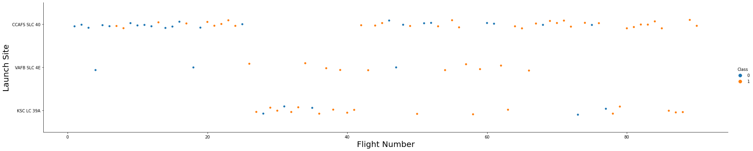
Flight Number vs. Launch Site
KSC LC 39A was not used for the first ~25 flights.
VAFB SLC 4E has been used much less frequently than the other two and hasn’t been used since ~flight 65.
CCAFS SLC 40 has been used the most but was not used from ~flight 25 to ~flight 40.
KSC LC 39A has a higher success rate than CCAFS SLC 40

Slide 18
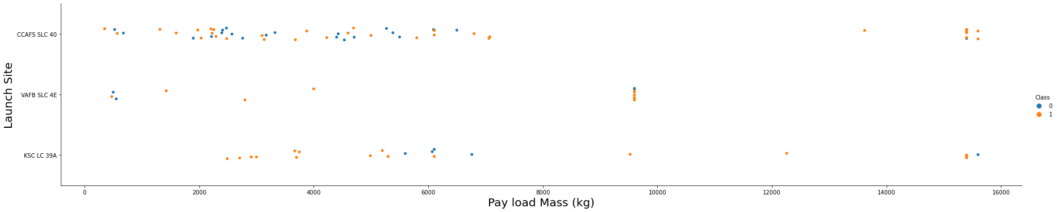
Payload vs. Launch Site
VAFB SLC 4E has not been used for a payload mass of larger than 10000kg.
CCAFS SLC 40 and KSC LC 39A both have handled payloads with mass > 10000kg.
Most payloads have a mass less than ~7000kg
KSC LC 39A has only been used for payloads with a mass greater than ~2500kg

Slide 19
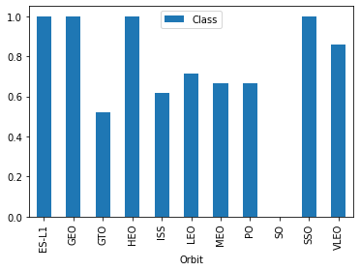
Success Rate vs. Orbit Type
ES-L1, GEO, HEO AND SSO orbits have 100% success rates.
Followed by (in order) VLEO, LEO, MEO & PO, ISS and GTO
SO has 0 success.

Slide 20
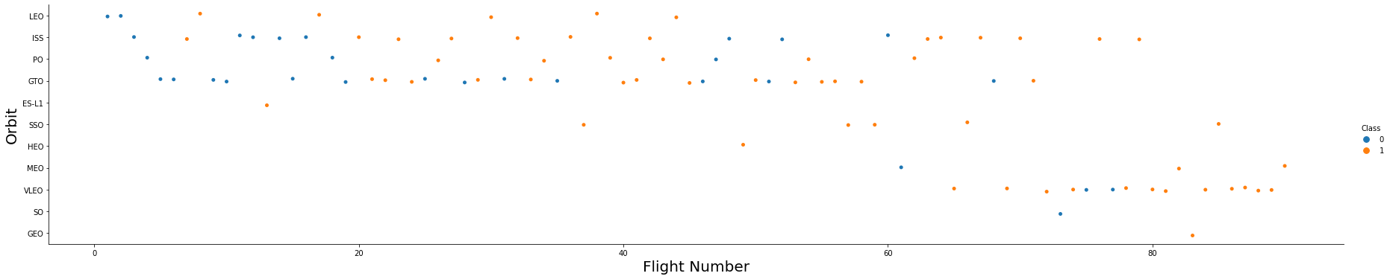
Flight Number vs. Orbit Type
LEO (~70%) has not been used since ~flight 45
ISS (~60%) was frequently used until ~flight 80
GTO (~55%) was frequently used ~flight 75
SSO (100%) is the only fully successful orbit that has been used more than once.
ES-L1, HEO, GEO (all 100%) and SO (0%) have only been used once
VLEO (~85%) has been used the most frequently since ~flight 65

Slide 21
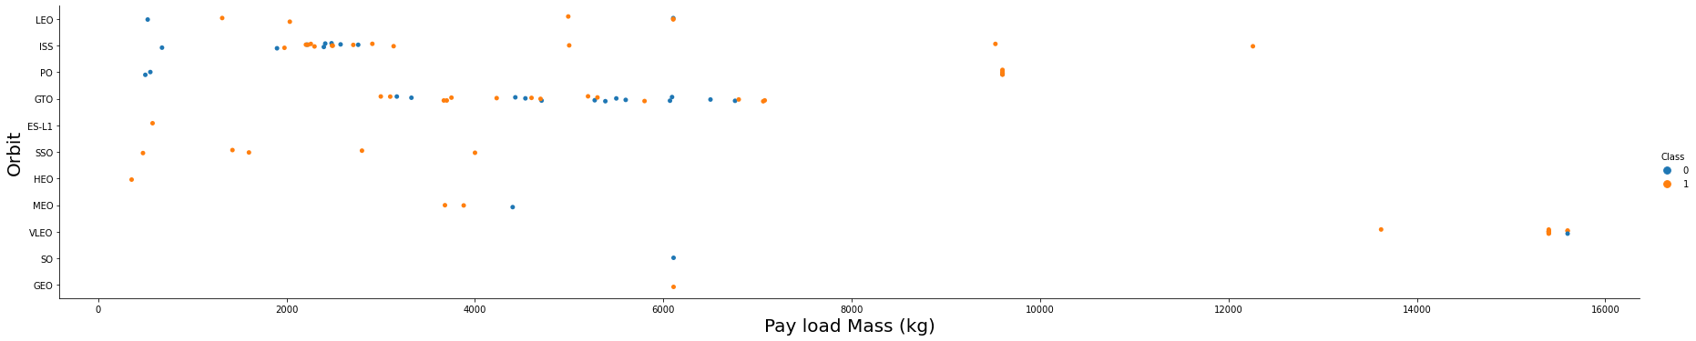
Payload vs. Orbit Type
VLEO was used for the heaviest payloads
ISS and PO were also used for heavier payloads
ISS was also used for most of the lighter payloads
GTO was mostly used for payloads with masses ranging from ~3000kg to ~7000kg

Slide 22
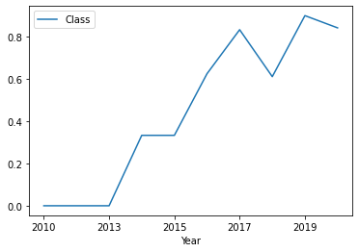
Launch Success Yearly Trend
The success rate has increased drastically from 2010 to 2020.
There was a dip in success rate in 2018.
There has been an upward trend.

Slide 23
All Launch Site Names
Names of the unique launch sites in the space mission:
SELECT DISTINCT LAUNCH_SITE FROM SPACEXDATASET
There are 4 distinct launch sites that have been used:
CCAFS LC-40
CCAFS SLC-40
KSC LC-39A
VAFB SLC-4E
launch_site
CCAFS LC-40
CCAFS SLC-40
KSC LC-39A
VAFB SLC-4E

Slide 24
Launch Site Names Begin with 'CCA'
5 records where launch sites begin with the string 'CCA’:
SELECT * FROM SPACEXDATASET WHERE LAUNCH_SITE LIKE 'CCA%' LIMIT 5
DATE | time__utc_ | booster_version | launch_site | payload | payload_mass__kg_ | orbit | customer | mission_outcome | landing__outcome
2010-06-04 | 18:45:00 | F9 v1.0 B0003 | CCAFS LC-40 | Dragon Spacecraft Qualification Unit | 0 | LEO | SpaceX | Success | Failure (parachute)
2010-12-08 | 15:43:00 | F9 v1.0 B0004 | CCAFS LC-40 | Dragon demo flight C1, two CubeSats, barrel of Brouere cheese | 0 | LEO (ISS) | NASA (COTS) NRO | Success | Failure (parachute)
2012-05-22 | 07:44:00 | F9 v1.0 B0005 | CCAFS LC-40 | Dragon demo flight C2 | 525 | LEO (ISS) | NASA (COTS) | Success | No attempt
2012-10-08 | 00:35:00 | F9 v1.0 B0006 | CCAFS LC-40 | SpaceX CRS-1 | 500 | LEO (ISS) | NASA (CRS) | Success | No attempt
2013-03-01 | 15:10:00 | F9 v1.0 B0007 | CCAFS LC-40 | SpaceX CRS-2 | 677 | LEO (ISS) | NASA (CRS) | Success | No attempt

Slide 25
Total Payload Mass
Calculate the total payload carried by boosters from NASA (CRS):
SELECT CUSTOMER, SUM(PAYLOAD_MASS__KG_) AS "TOTAL PAYLOAD MASS CARRIED (KG)" FROM SPACEXDATASET WHERE CUSTOMER = 'NASA (CRS)' GROUP BY CUSTOMER
Sum of all payload mass carried by boosters from NASA equals to 45596kg.
customer | TOTAL PAYLOAD MASS CARRIED (KG)
NASA (CRS) | 45596

Slide 26
Average Payload Mass by F9 v1.1
Calculate the average payload mass carried by booster version F9 v1.1:
SELECT BOOSTER_VERSION, AVG(PAYLOAD_MASS__KG_) "AVERAGE PAYLOAD MASS CARRIED (KG)" FROM SPACEXDATASET WHERE BOOSTER_VERSION = 'F9 v1.1' GROUP BY BOOSTER_VERSION
The average payload mass carried by a F9 v1.1 booster is 2928kg.
booster_version | AVERAGE PAYLOAD MASS CARRIED (KG)
F9 v1.1 | 2928

Slide 27
First Successful Ground Landing Date
Find the dates of the first successful landing outcome on ground pad:
SELECT MIN(DATE) FROM SPACEXDATASET WHERE LANDING__OUTCOME = 'Success (ground pad)’
The first successful landing on a ground pad occurred on the 22nd of December in the year 2015.
1
2015-12-22

Slide 28
Successful Drone Ship Landing with Payload between 4000 and 6000
List the names of boosters which have successfully landed on drone ship and had payload mass greater than 4000 but less than 6000:
SELECT PAYLOAD, PAYLOAD_MASS__KG_, LANDING__OUTCOME FROM SPACEXDATASET WHERE LANDING__OUTCOME LIKE '%Success%' AND PAYLOAD_MASS__KG_ BETWEEN 4001 AND 5999
Payloads that have successfully landed on a drone ship with a mass between 4000kg and 6000kg are listed in the table.
payload | payload_mass__kg_ | landing__outcome
JCSAT-14 | 4696 | Success (drone ship)
JCSAT-16 | 4600 | Success (drone ship)
SES-10 | 5300 | Success (drone ship)
NROL-76 | 5300 | Success (ground pad)
Boeing X-37B OTV-5 | 4990 | Success (ground pad)
SES-11 / EchoStar 105 | 5200 | Success (drone ship)
Zuma | 5000 | Success (ground pad)
Merah Putih | 5800 | Success
Es hail 2 | 5300 | Success
Nusantara Satu, Beresheet Moon lander, S5 | 4850 | Success
RADARSAT Constellation, SpaceX CRS-18 | 4200 | Success
GPS III-03, ANASIS-II | 4311 | Success
ANASIS-II, Starlink 9 v1.0 | 5500 | Success
GPS III-04 , Crew-1 | 4311 | Success

Slide 29
Total Number of Successful and Failure Mission Outcomes
Calculate the total number of successful and failure mission outcomes:
SELECT LANDING__OUTCOME, COUNT(*) "Sum of Outcomes" FROM SPACEXDATASET WHERE LANDING__OUTCOME LIKE '%Success%' OR LANDING__OUTCOME LIKE '%Failure%' GROUP BY LANDING__OUTCOME
In total, 10 occurrences had a failed landing outcome, whereas 61 were successful
landing__outcome | Sum of Outcomes
Failure | 3
Failure (drone ship) | 5
Failure (parachute) | 2
Success | 38
Success (drone ship) | 14
Success (ground pad) | 9

Slide 30
Boosters Carried Maximum Payload
List the names of the booster which have carried the maximum payload mass:
SELECT PAYLOAD, PAYLOAD_MASS__KG_ FROM SPACEXDATASET WHERE PAYLOAD_MASS__KG_ = (SELECT MAX(PAYLOAD_MASS__KG_) FROM SPACEXDATASET)
All payloads which have carried the maximum payload mass so far (15600kg) are listed in the table. They are all Starlinks.
payload | payload_mass__kg_
Starlink 1 v1.0, SpaceX CRS-19 | 15600
Starlink 2 v1.0, Crew Dragon in-flight abort test | 15600
Starlink 3 v1.0, Starlink 4 v1.0 | 15600
Starlink 4 v1.0, SpaceX CRS-20 | 15600
Starlink 5 v1.0, Starlink 6 v1.0 | 15600
Starlink 6 v1.0, Crew Dragon Demo-2 | 15600
Starlink 7 v1.0, Starlink 8 v1.0 | 15600
Starlink 11 v1.0, Starlink 12 v1.0 | 15600
Starlink 12 v1.0, Starlink 13 v1.0 | 15600
Starlink 13 v1.0, Starlink 14 v1.0 | 15600
Starlink 14 v1.0, GPS III-04 | 15600
Starlink 15 v1.0, SpaceX CRS-21 | 15600

Slide 31
2015 Launch Records
List the failed landing outcomes in drone ship, their booster versions, and launch site names for in year 2015:
SELECT DATE, PAYLOAD, BOOSTER_VERSION, LAUNCH_SITE, LANDING__OUTCOME FROM SPACEXDATASET WHERE LANDING__OUTCOME = 'Failure (drone ship)' AND DATE LIKE '%2015%’
In 2015, two landings failed when attempting to land on a drone ship.
DATE | payload | booster_version | launch_site | landing__outcome
2015-01-10 | SpaceX CRS-5 | F9 v1.1 B1012 | CCAFS LC-40 | Failure (drone ship)
2015-04-14 | SpaceX CRS-6 | F9 v1.1 B1015 | CCAFS LC-40 | Failure (drone ship)

Slide 32
Rank Landing Outcomes Between 2010-06-04 and 2017-03-20
Rank the count of outcomes from 2010-06-04 to 2017-03-20, descending order:
SELECT LANDING__OUTCOME, COUNT(LANDING__OUTCOME) "COUNT OF LANDING OUTCOME" FROM SPACEXDATASET WHERE DATE BETWEEN '2010-06-04' AND '2017-03-20' GROUP BY LANDING__OUTCOME ORDER BY 2 DESC
Drone ship successes and failures have the most occurrences when attempting a land.
landing__outcome | COUNT OF LANDING OUTCOME
No attempt | 10
Failure (drone ship) | 5
Success (drone ship) | 5
Controlled (ocean) | 3
Success (ground pad) | 3
Failure (parachute) | 2
Uncontrolled (ocean) | 2
Precluded (drone ship) | 1

Slide 33


Slide 34

Launch Site Locations
All four launch sites have been marked on the US map.
VAFB SLC-4E is located on the west coast at California.
CCAFS LC-40, CCAFS SLC-40 and KSC LC-39A are all located on the east coast at Florida.

Slide 35
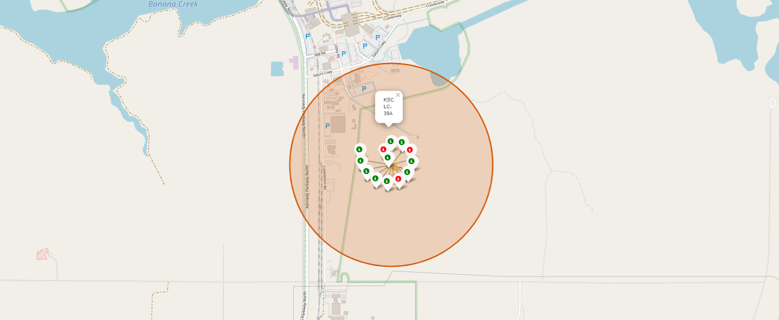
KSC LC-39A Landing Outcomes
10 Successes (Green), 3 Failures (Red)

Slide 36

Proximity Marking
Closest coastline (0.89km), railway (0.59km) and highway (1.29km)

Slide 37


Slide 38
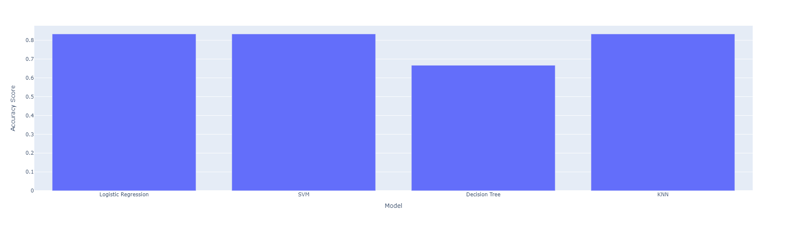
Classification Accuracy
All models have the same accuracy (~83.33%) except Decision Tree which is lower (~66.66%).

Slide 39
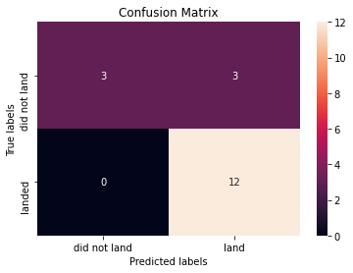
Confusion Matrix
Confusion Matrix for Logistic Regression, SVM and KNN models.
6 of the occurrences in the test data did not land successfully. The models predicted correctly for 3 of these cases.
The remaining 12 occurrences in the test data did land successfully. The models predicted correctly for all these cases.

Slide 40

Conclusions
KSC LC 39A launch site has had a good number of launches and a high success rate.
VLEO orbit has had a high success rate and a good number of launches also.
They both have also been used for heavier payloads
Logistic Regression, SVM or KNN can be used to predict the landing outcomes of a launch with the same accuracy in the prediction.

Slide 41


